Slide 1
SPARK_SQL

Slide 2
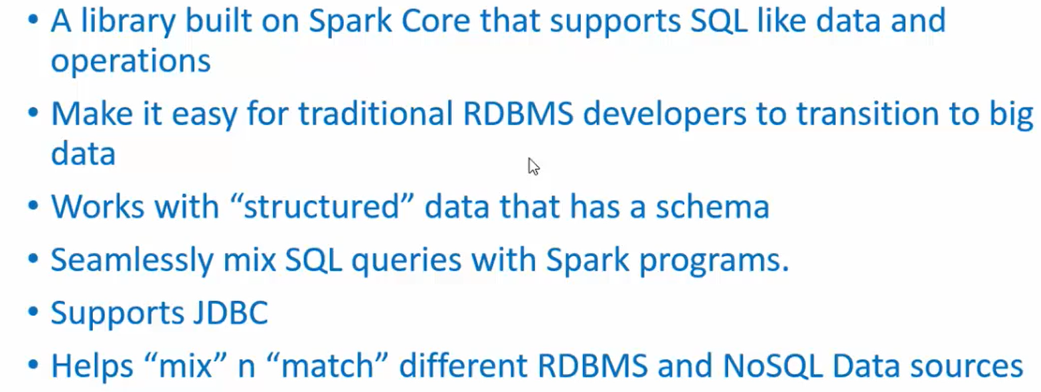
Overview

Slide 3
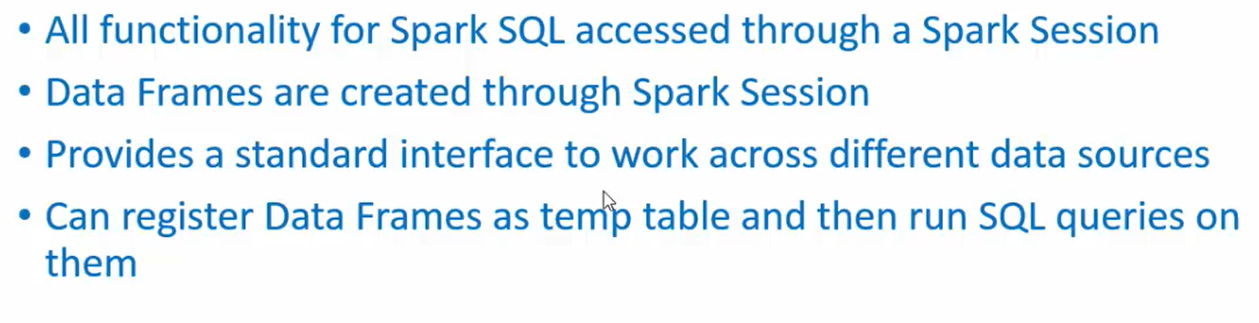
SPARK SESSION

Slide 4
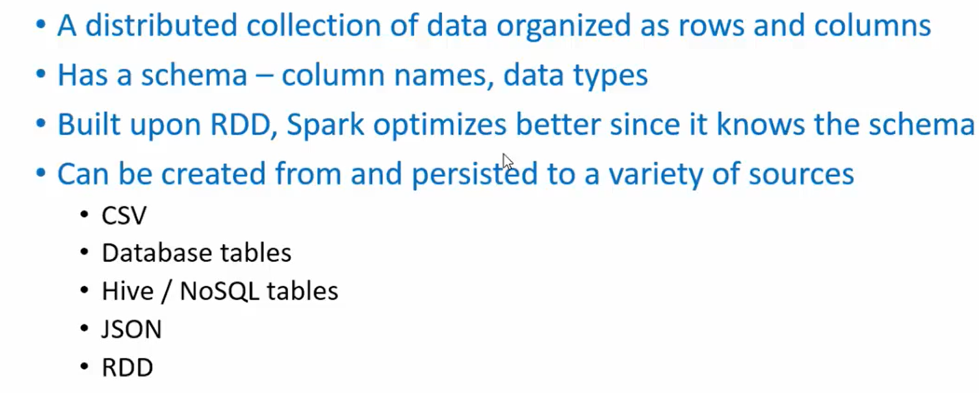
DATAFRAME

Slide 5
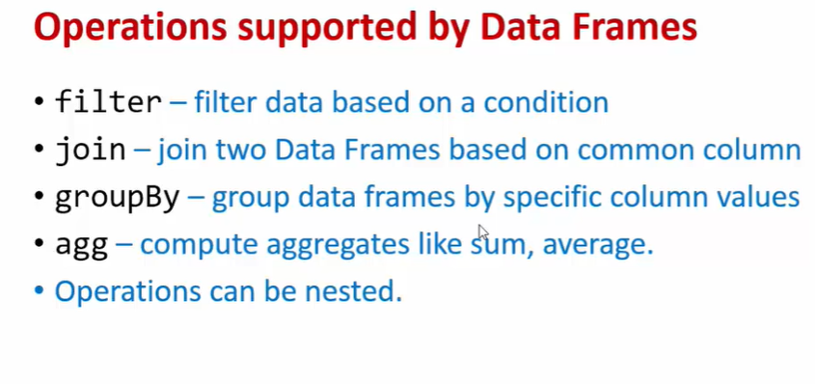

Slide 7
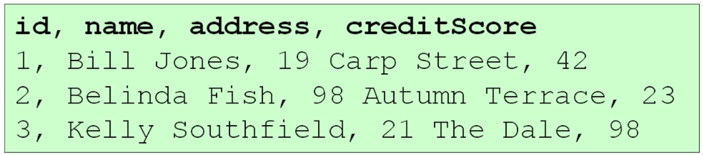
Structured DATA

Slide 8
So the data frame or data set API is a Java API that we can use to manipulate and query this structured big data.

Slide 9
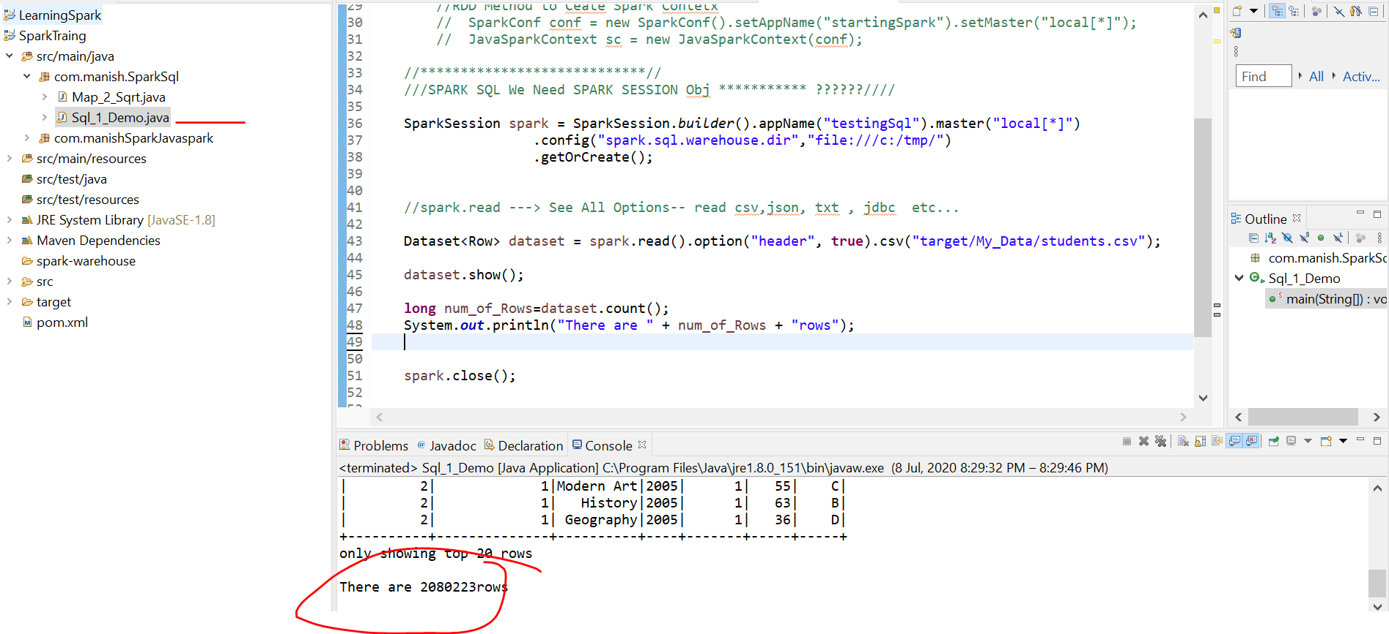

Slide 10
SPARK SQL DATASETS

Slide 11
DATE FORMATTING

Slide 12
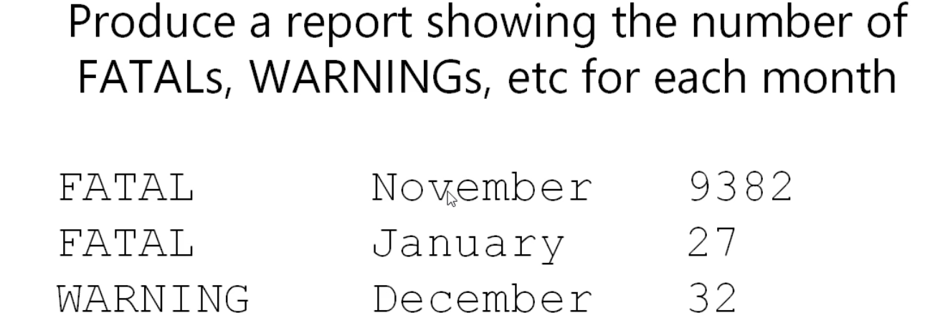

Slide 13
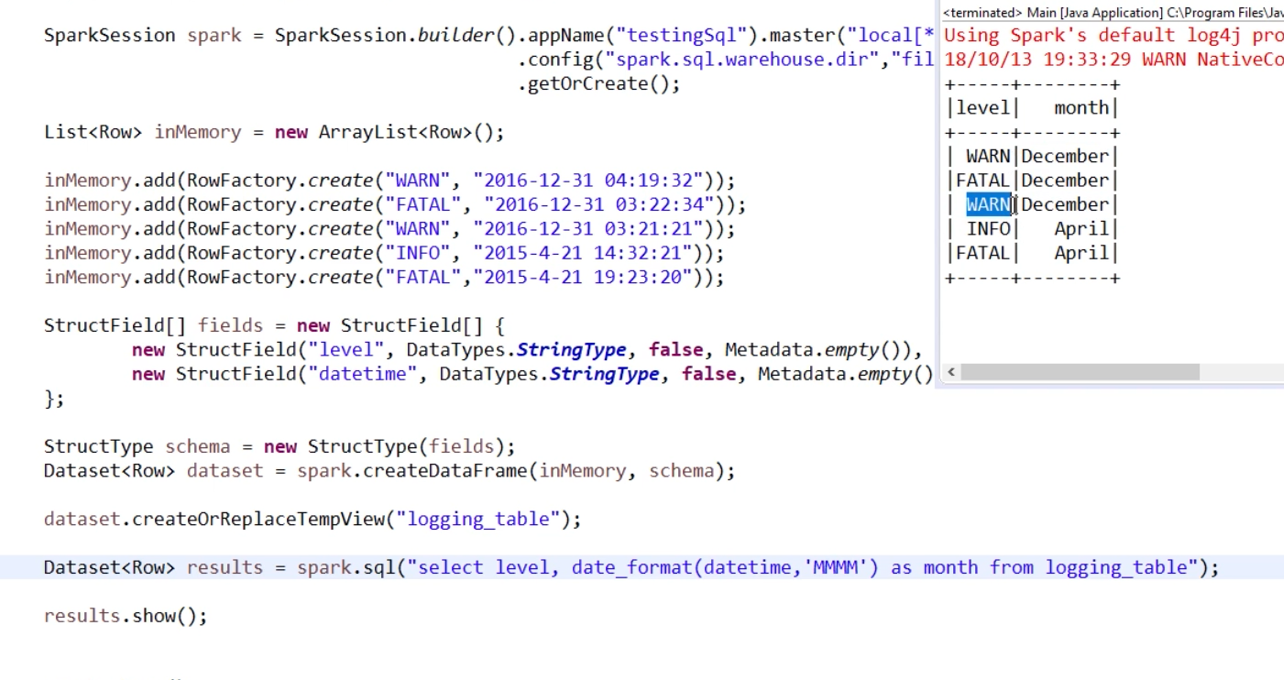

Slide 14
Group By 2 Columns :: Level & MOnth

Slide 16
DATAFRAME API
Java API in Sparke SQL called the data frame API.
Till Now we have seen So Many SQL SYNTAX API But
There is a pure Java API that can achieve exactly the same things so that you can go further with the Java API.
Data frame's is just a synonym for A data set of rows.
They also now support data sets of regular Java object so I could create a class like customer and I could get a data set of customers.

Slide 17
Talking about data frame's them was specifically talking about data sets of rows but with data set you can have data sets of anything data e.g :: sets of customers data sets of shopping carts or whatever.
traditional name for this DataSet API is the data frame API

Slide 18
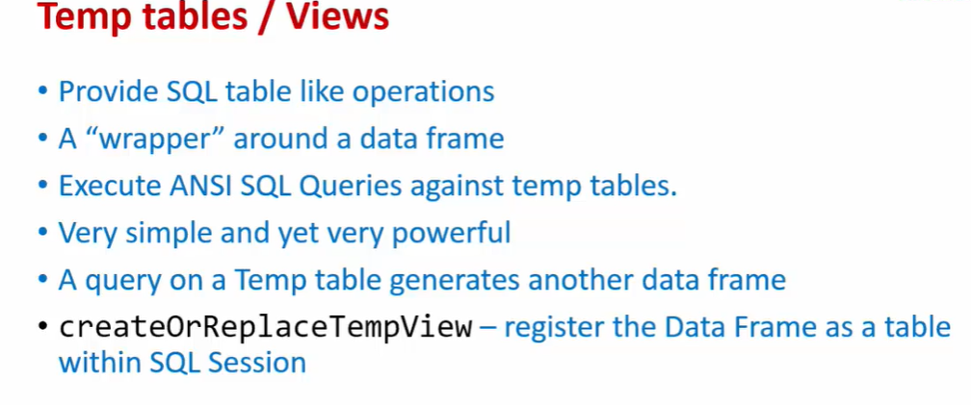

Slide 20
USER DEFINED FUNCTION

Slide 21
Lets ADD Some Extra Column in The dataset

Slide 22
Till 31

Slide 23
PERFORMANCE

Slide 24
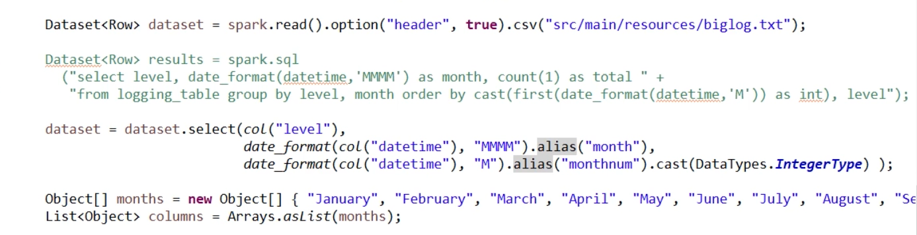
2 Syntax To Do Same Thing :: Which is Better

Slide 25
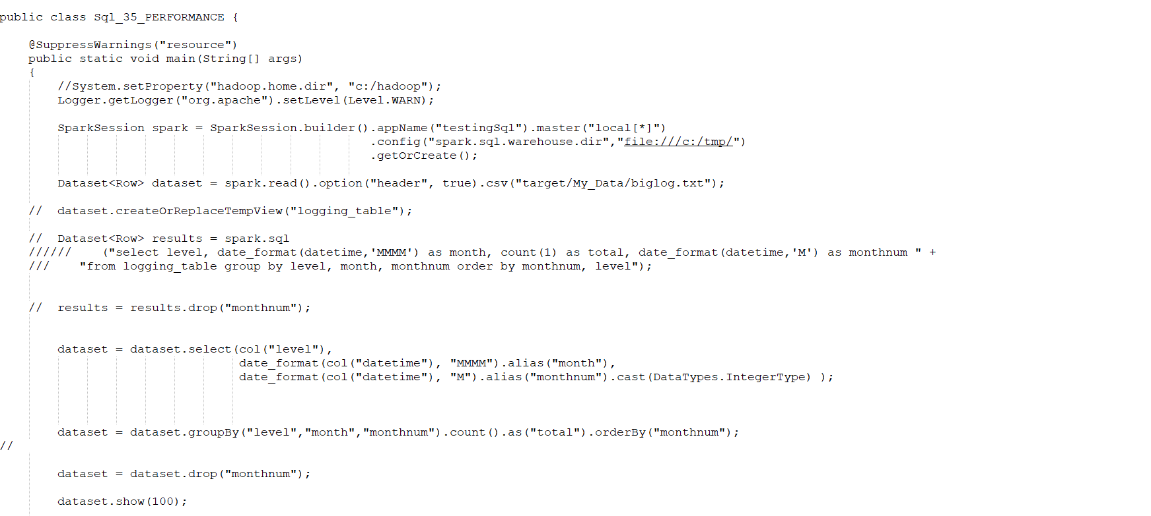

Slide 26
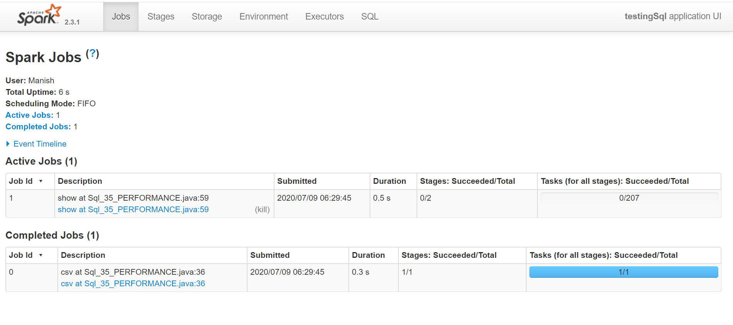

Slide 27
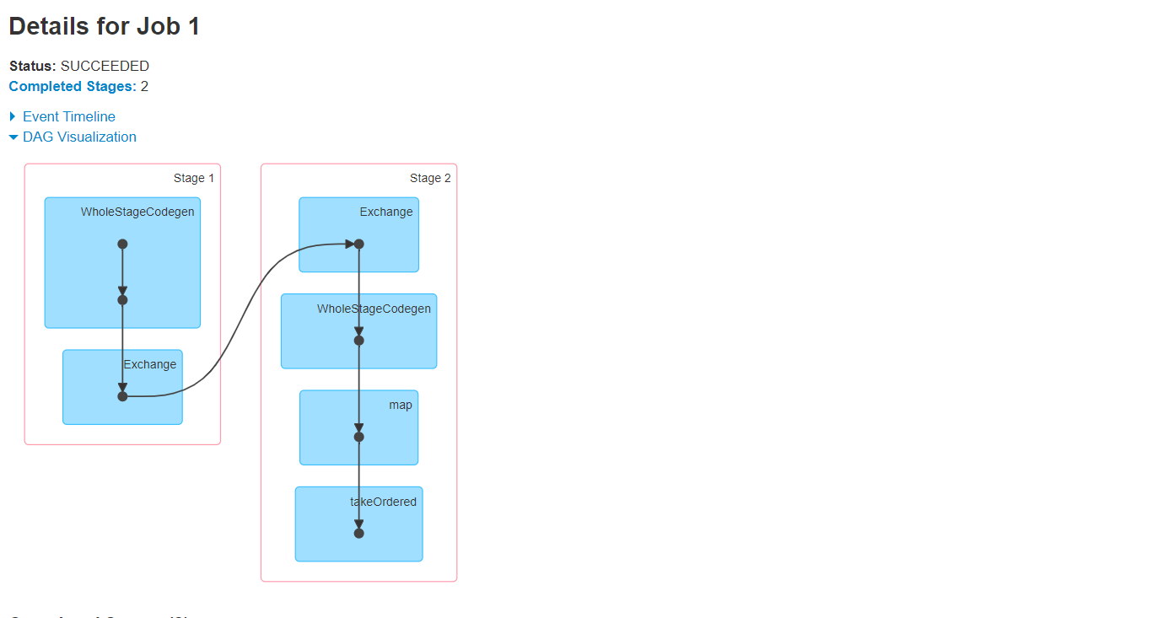

Slide 28
Now run java version

Slide 29
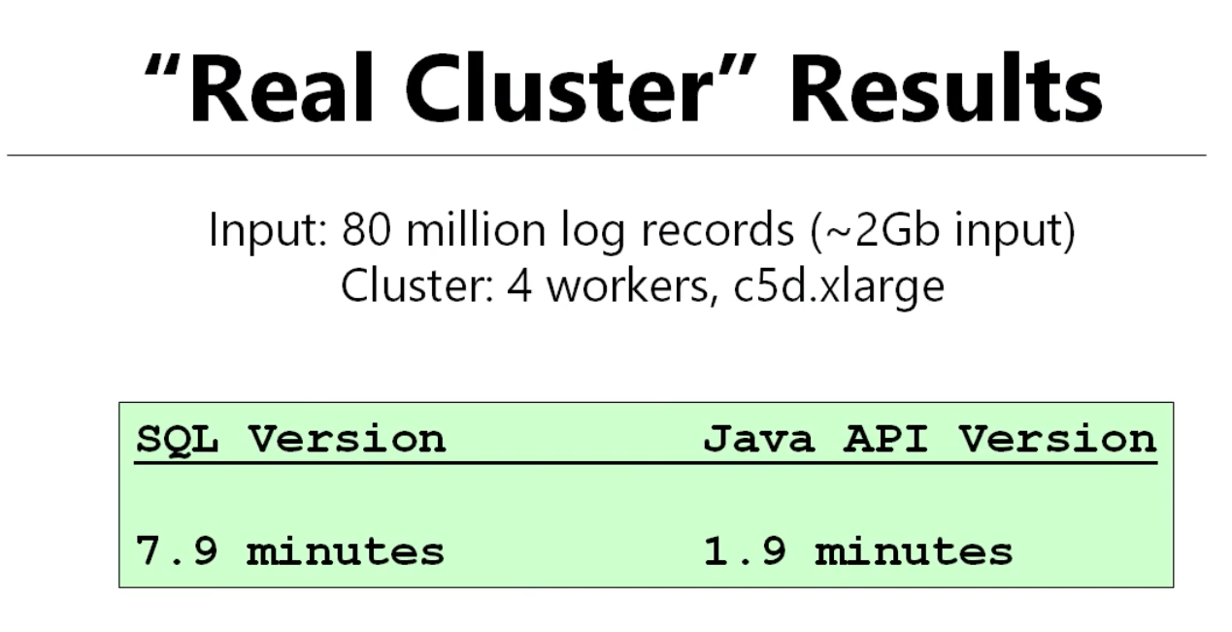

Slide 30
- Setting spark.sql.shuffle.partitions

Slide 31
problem when you have small jobs in Spark SQL.
When grouping is going on → It need to shuffle data around and
in order to do the shuffle it's going to create some partitions of data.
There's going to be a task assigned to that partition.
SPARK SQL needs to make a decision as to how many partitions to use and it simply works from a property value.

Slide 32
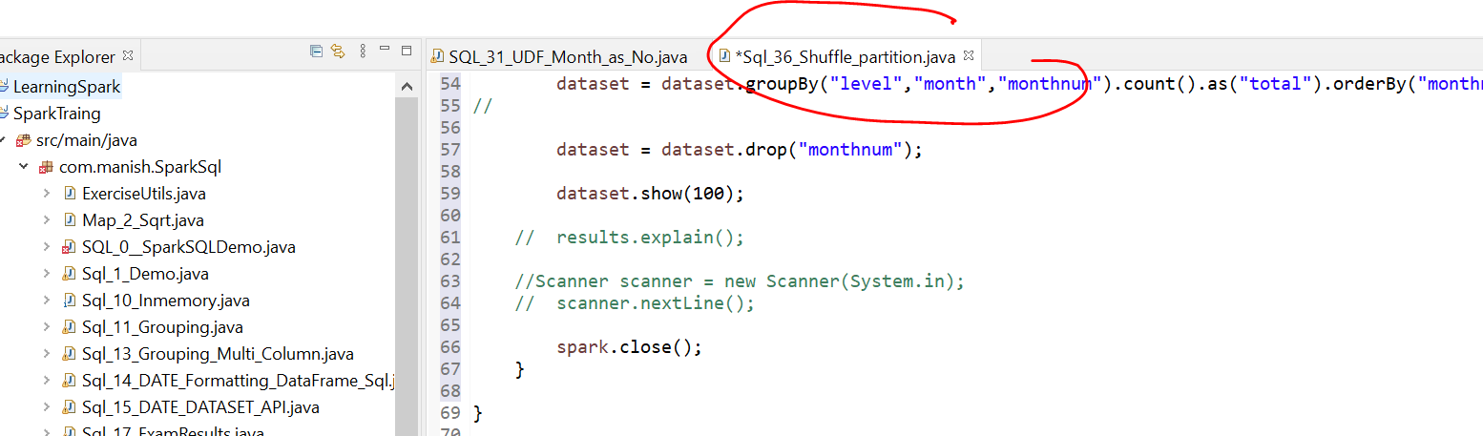

Slide 33
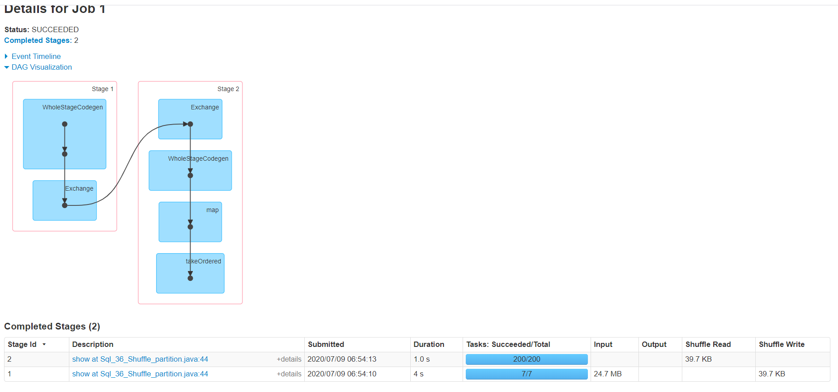

Slide 34


Slide 35
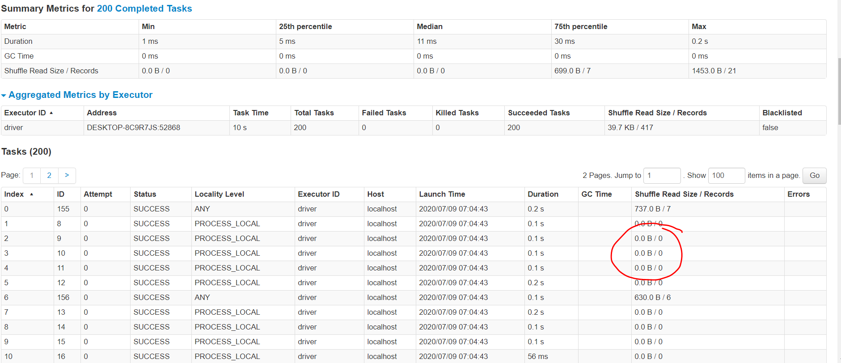

Slide 36
And we know from our output table that we have five logging levels in 12 months so.
So actually the results of the shuffle is going to be 60 individual keys in the output.

Slide 37
So keep an eye out for this..
if you're working in as SPARK SQL and you have a shuffle stage and the shuffle doesn't have a big output.
DAG will show that there’s a lot of unused tasks then this is something you might want to configure.

Slide 38
spark.conf().set("spark.sql.shuffle.partitions", 3);

Slide 39
